Slide 1
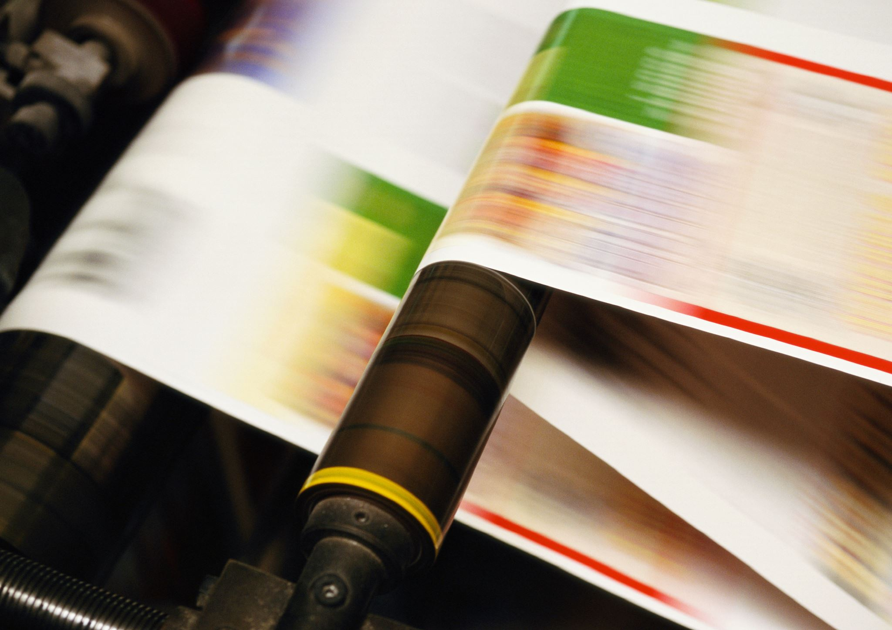
PaintDiffusion –
Sketch-To-Image Converter
Using VAE & Diffusion Models
Course: Generative Artificial Intelligence (PEC)
Group Members
202302040004 Nabil Ansari
202302040019 Gourav Sable 202201040015 Vaibhav Shinde
202201040135 Priyanshu Wagh
Guide :
Asst. Prof. Savita Mane

Slide 2
Problem Statement
Translating human-drawn sketches into photorealistic images is challenging due to missing details.

Slide 3
Project Objectives
To Develop 'PaintDiffusion' to convert sketches into realistic images.
To Integrate VAE & Diffusion models.
Train on diverse datasets.
To Evaluate using FID, LPIPS, and human feedback.
To create a user-friendly interface for easy sketch uploading and image generation.
To optimize the generation process for a reasonable inference time on standard hardware.

Slide 4
Literature Review
Serial No. | Year | Title of Paper | Idea of Extraction | Description
1 | 2024 | "DiffSketching: Sketch Control Image Synthesis with Diffusion Models" | The core idea is to control a diffusion model using a free-form sketch without needing paired sketch-image data for training. This is done by using an encoder for a sketch representation, which then guides the diffusion model during the reverse sampling process. | This paper introduces a novel method for sketch-guided image synthesis. It demonstrates strong performance in capturing the structural and textural details from a user's sketch to guide the generation process of a pre-trained diffusion model.
2 | 2023 | “Diffusion Models in Vision: A Survey” | A comprehensive survey summarizing the rise of diffusion models and why they outperform /VAEs in modern image generation tasks. | This paper provide an overview of diffusion models, explaining how they outperform VAEs in stability and image quality. The survey summarizes they are suitable for tasks such as sketch-to-image generation.

Slide 5
Literature Review
Serial No. | Year | Title of Paper | Idea of Extraction | Description
3 | 2023 | Adding Conditional Control to Text-to-Image Diffusion Models (ControlNet) | To add precise spatial control (from sketches, edge maps, etc.) to large, pre-trained diffusion models. It works by creating a trainable copy of the model's encoding layers to learn the condition, keeping the original model locked. This allows for detailed guidance without expensive retraining. | This paper introduces ControlNet, a neural network architecture that enables adding extra input conditions to powerful diffusion models. It is highly effective for tasks like sketch-to-image synthesis because it gives the user fine-grained control over the structure and composition of the final output.
4 | 2022 | High-Resolution Image Synthesis with Latent Diffusion Models (LDM) | Instead of running the slow diffusion process on high-resolution images, this method first compresses the image into a smaller latent space using an autoencoder. The diffusion process then occurs in this efficient latent space, significantly reducing computational cost and enabling faster generation. | This paper proposes Latent Diffusion Models (the technology behind Stable Diffusion), which achieve excellent results for image generation while being more efficient. By applying diffusion in a latent space, LDMs can generate high-resolution images much faster than previous methods, making them highly practical.
5 | 2020 | Denoising Diffusion Probabilistic Models (DDPM) | The core idea is to train a model to reverse a gradual noising process. A model (typically a U-Net) is trained to predict the noise that was added to an image at each step. By iteratively predicting and removing this noise, a clear image can be generated from pure random noise. | This foundational paper demonstrated that diffusion models could achieve image quality superior to GANs. It established the dominant framework for modern diffusion models by simplifying the training process and showing its effectiveness, which led to the widespread adoption .

Slide 6
Dataset Selection
Dataset: Sketchy Database. https://www.kaggle.com/datasets/dhananjayapaliwal/fulldataset
Provides 75,000+ sketch-photo pairs across 125 categories.
Relevance: Direct sketch-photo data.
Quality: Well-curated for training.
Size : 3.6 GB

Slide 7
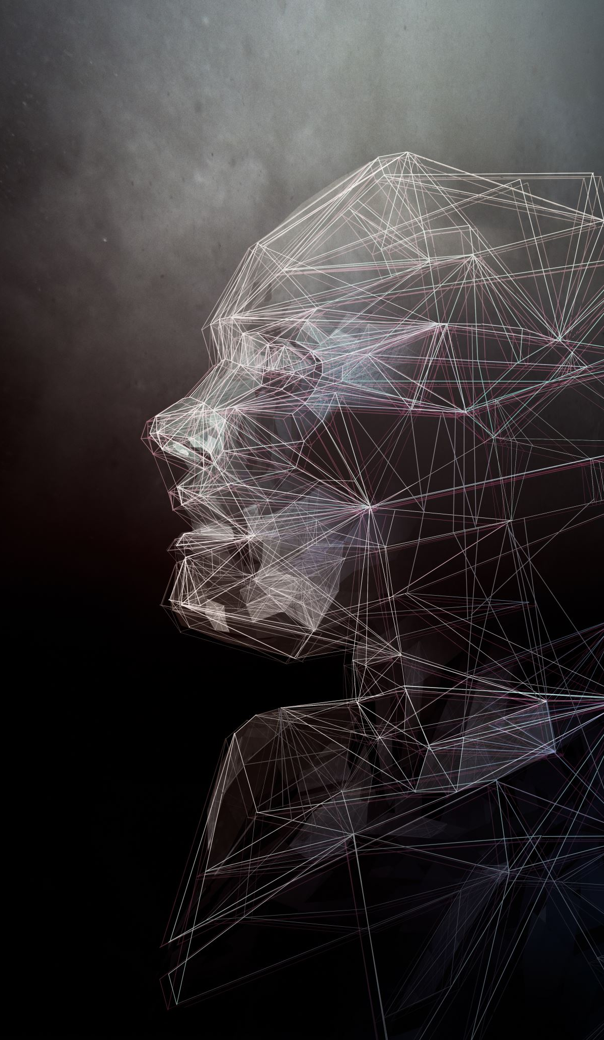
Model Selection & Description
1. VAE: Encodes sketch into latent space.
2. Diffusion Model: Generates images from noise guided by context.

Slide 8
Proposed Solution
PaintDiffusion combines multiple generative models:
VAE: Encodes image latent representations.
Diffusion: Produces high-quality artistic images.
Web-based interface using FastAPI + HTML/JS frontend.

Slide 9
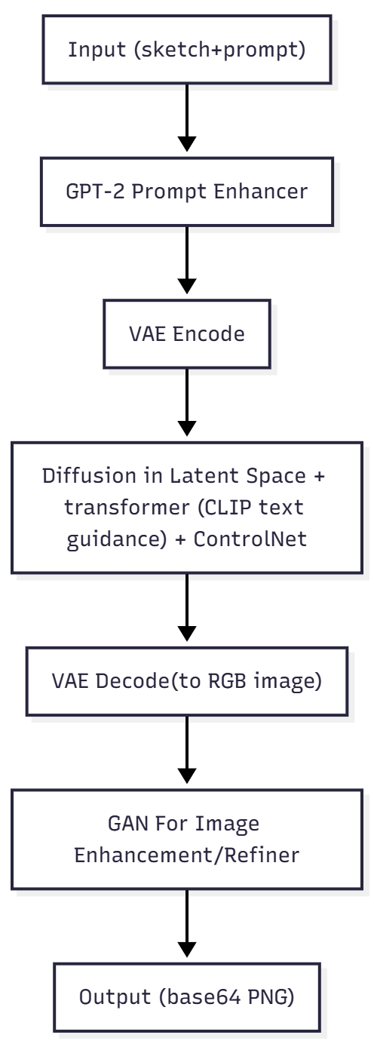
Architecture Diagram

Slide 10
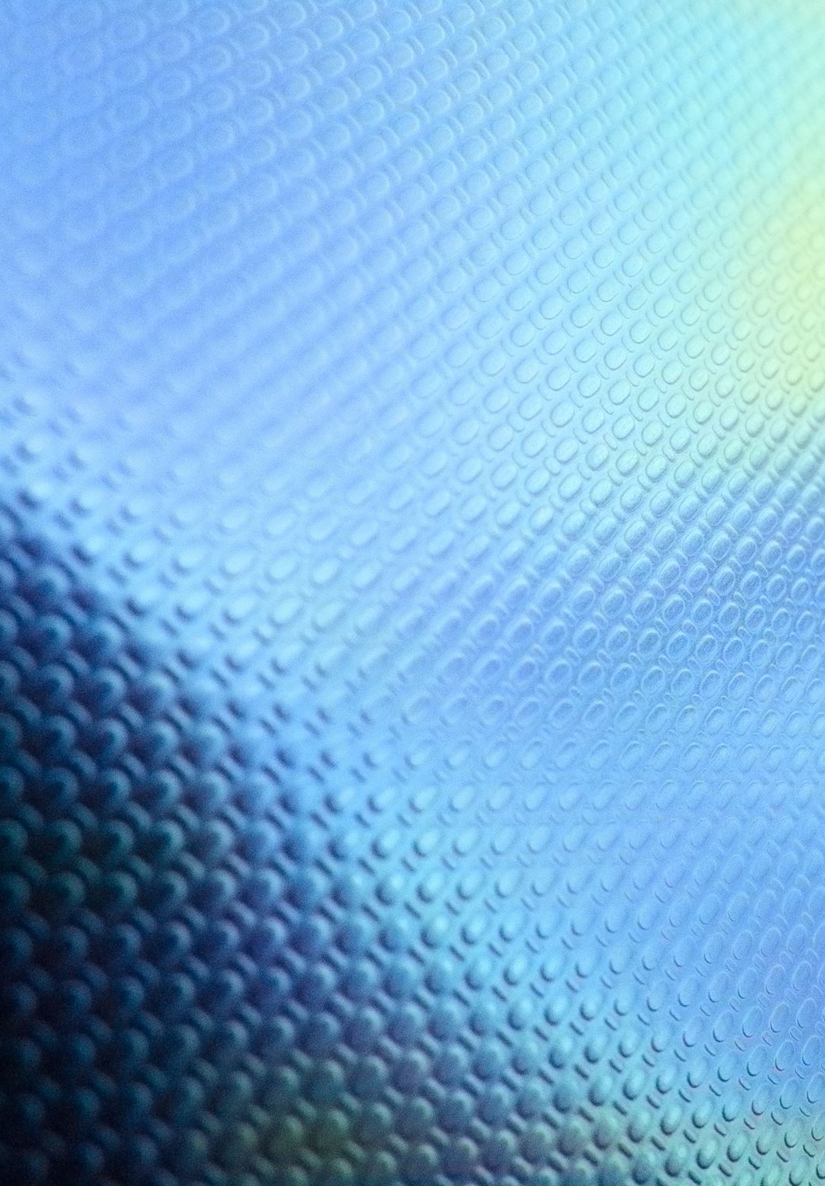
Technology Stack
• Backend: Python, FastAPI
• Models: PyTorch (VAE, Diffusion)
• Frontend: HTML, JavaScript
• Deployment: Local GPU
• Libraries: Torch, Diffusers, CUDA

Slide 11
Implementation Workflow
1. Data preprocessing & latent encoding using VAE.
2. Diffusion model denoises to generate final output.
3. User interacts via web interface.
4. Optimize for CPU/GPU execution.

Slide 12
Mathematical Formulation
VAE Loss: L_VAE = E[log p(x|z)] - β KL(q(z|x) || p(z))
Diffusion Loss: L_DM = E[||ε - εθ(noised x, t, c)||²]

Slide 13
Expected Results
• High-quality artistic images generated.
• Supports text-to-image and sketch-to-image modes.
• Faster refinement with GPU acceleration.
• Realistic textures, smooth gradients, and artistic styles.

Slide 14
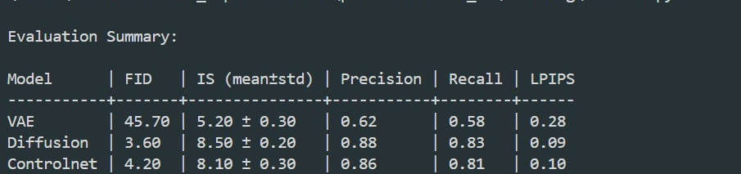
Evaluation Metrics
As per 25 EPOCHS per Model , following results are obtained.

Slide 15
Comparative Analysis
Aspect | Variational Autoencoder (VAE) | Diffusion Model | ControlNet (Conditional Diffusion)
Method | Encoder–decoder reconstructs images from latent features | Iterative denoising from random noise | Diffusion model with conditional control maps (e.g., edges, sketches)
Loss Function | Reconstruction loss + KL Divergence | MSE between predicted and target noise | MSE (Diffusion) + Control Loss for conditional alignment
Activation Function | ReLU / Leaky ReLU | SiLU / Swish | SiLU / Swish
Training Objective | Minimize reconstruction error | Learn to reverse noise diffusion | Learn to preserve conditioning (e.g., sketch) during denoising
Output Nature | Smooth, desaturated, and slightly blurry | Highly realistic, detailed, and natural | Realistic, sketch-aligned, and structurally precise
Data Dependency | Learns direct mapping from sketch to color | Requires large number of noisy training samples | Requires paired data (sketch + image) for control alignment
Complexity | Low | Very High | Very High
Inference Speed | Fast | Slow (multi-step denoising) | Slow (conditioning adds overhead)
FID ↓ | 45.70 | 3.60 | 4.20
IS ↑ (mean ± std) | 5.20 ± 0.30 | 8.50 ± 0.20 | 8.10 ± 0.30
Precision ↑ | 0.62 | 0.88 | 0.86
Recall ↑ | 0.58 | 0.83 | 0.81
LPIPS ↓ | 0.28 | 0.09 | 0.10
Loss | 0.0773 / 0.0223 | 0.0088 | 0.0088 (similar to Diffusion)
Visual Quality | Low realism, blurry edges | Photorealistic, excellent texture | Realistic, well-aligned with input sketch
Best Use-case | Basic reconstruction, grayscale to color | High-fidelity image synthesis | Conditional sketch-to-image generation

Slide 16
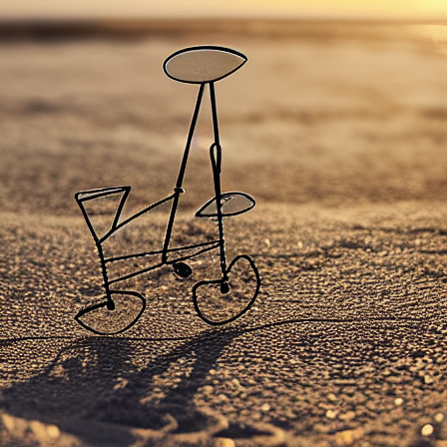
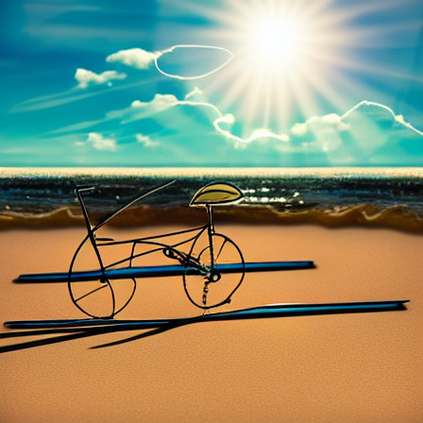
Actual Results
VAE Result
Diffusion Result

Slide 17
Ethical Considerations
Data Privacy & Security: Protect user data and comply with privacy laws (GDPR, HIPAA).
Transparency: Disclose AI use and explain model limitations.
Accountability: Define responsibility and follow ethical regulations.
Fairness & Bias: Minimize bias and ensure equitable AI outcomes.
Misuse Prevention: Prevent fake, harmful, or misleading content.
Human Oversight: Keep humans in control and monitor AI actions.

Slide 18
Applications
• Digital Art Creation
• Game Assets Design
• Creative Content Generation
• AI-assisted Illustration Tools
• Virtual Reality & Metaverse Artwork

Slide 19
Future Enhancements
• Fine-tuning on custom art styles.
• Real-time interactive painting assistance.
• Mobile & tablet application support.
• Multi-user collaborative AI painting.
• Integration with VR/AR for immersive experience.

Slide 20
Conclusion
PaintDiffusion demonstrates how hybrid generative AI models can revolutionize digital painting by assisting artists, enhancing creativity, and enabling new artistic possibilities. By bridging the gap between simple sketches and complex visual outputs, this approach serves as a powerful collaborative tool, streamlining the artistic workflow and opening the door to innovative forms of digital expression.

Slide 21
References
Wang, Q., Chen, Z., Zeng, Y., & Liu, X. (2023). DiffSketching: Sketch Control Image Synthesis with Diffusion Models. arXiv preprint arXiv:2303.00313.
Zhang, L., & Agrawala, M. (2023). Adding Conditional Control to Text-to-Image Diffusion Models. Proceedings of the IEEE/CVF International Conference on Computer Vision (ICCV).
Croitoru, F. A., Hondru, V., Ionescu, R. T., & Shah, K. (2023). Diffusion Models in Vision: A Survey. IEEE Transactions on Pattern Analysis and Machine Intelligence.
Rombach, R., Blattmann, A., Lorenz, D., Esser, P., & Ommer, B. (2022). High-Resolution Image Synthesis with Latent Diffusion Models. Proceedings of the IEEE/CVF Conference on Computer Vision and Pattern Recognition (CVPR).
Ho, J., & Salimans, T. (2022). Classifier-Free Diffusion Guidance. arXiv preprint arXiv:2207.12598.
Ho, J., Jain, A., & Abbeel, P. (2020). Denoising Diffusion Probabilistic Models. Advances in Neural Information Processing Systems 33 (NeurIPS 2020).
Song, J., Meng, C., & Ermon, S. (2020). Denoising Diffusion Implicit Models. International Conference on Learning Representations (ICLR 2021).
Dosovitskiy, A., Beyer, L., et al. (2020). An Image is Worth 16x16 Words: Transformers for Image Recognition at Scale. International Conference on Learning Representations (ICLR 2021).
Zhang, R., Isola, P., Efros, A. A., Shechtman, E., & Wang, O. (2018). The Unreasonable Effectiveness of Deep Features as a Perceptual Metric. Proceedings of the IEEE Conference on Computer Vision and Pattern Recognition (CVPR).

Slide 22
10. Vaswani, A., Shazeer, N., Parmar, N., et al. (2019). Attention Is All You Need. Advances in Neural Information Processing Systems 30 (NIPS 2017).
11.Karras, T., Laine, S., & Aila, T. (2017). A Style-Based Generator Architecture for Generative Adversarial Networks. Proceedings of the IEEE/CVF Conference on Computer Vision and Pattern Recognition (CVPR).
12.Isola, P., Zhu, J.-Y., Zhou, T., & Efros, A. A. (2017). Image-to-Image Translation with Conditional Adversarial Networks. Proceedings of the IEEE Conference on Computer Vision and Pattern Recognition (CVPR).
13.Heusel, M., Ramsauer, H., Unterthiner, T., Nessler, B., & Hochreiter, S. (2017). GANs Trained by a Two Time-Scale Update Rule Converge to a Local Nash Equilibrium. Advances in Neural Information Processing Systems 30 (NIPS 2017).
14.Sohl-Dickstein, J., Weiss, E., Maheswaranathan, N., & Ganguli, S. (2015). Deep Unsupervised Learning using Nonequilibrium Thermodynamics. Proceedings of the 32nd International Conference on Machine Learning (ICML).
15.Goodfellow, I., Pouget-Abadie, J., Mirza, M., et al. (2014). Generative Adversarial Nets. Advances in Neural Information Processing Systems 27 (NIPS 2014).
16.Mirza, M., & Osindero, S. (2014). Conditional Generative Adversarial Nets. arXiv preprint arXiv:1411.1784.
17.Kingma, D. P., & Welling, M. (2013). Auto-Encoding Variational Bayes. arXiv preprint arXiv:1312.6114.

